Slide 1
COMA

Slide 2
THE UNCONSIOUS PATIENT

Slide 3
Introduction
Management of the unconscious patient is never an easy task .
Assessment of the comatose patient is made difficult because of the many and varied causes as well as the limited time available for appropriate diagnosis and therapeutic judgement.

Slide 4
In some situations delay of a few hrs would result in irreversible neuronal damage.
Clinical and investigatory approach should therefore be precise.
Supportive laboratory tests giving indirect information should best be avoided in order to save time.

Slide 5
Sleep is unconsciousness from which the person can be aroused by sensory or other stimuli
Coma is unconsciousness from which the person cannot be aroused

Slide 6
Consciousness Is Dependent on an Intact Ascending Reticular Activating System (RAS)
excitatory area located in the reticular substance of the upper mid-pons and mesencephalon
Inhibitory area located in the reticular substance of the lower mid-pons and medulla

Slide 7
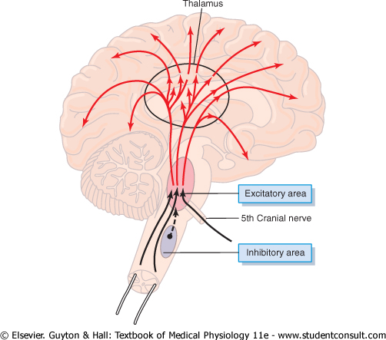
RAS

Slide 8
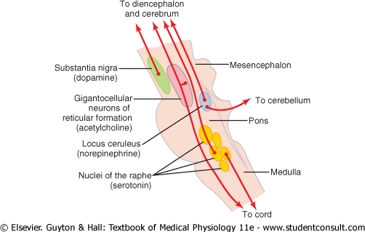
RAS

Slide 9
Assessment of the level of Consciousness
A. Neurologic:
- States of Altered Consciousness
B. Neurosurgical: GCS or AVPU

Slide 10
States of Altered Consciousness
Lethargy :fatigued with minimal difficulty maintaining alertness
Obtunded :moderate reduction in alertness with decreased interest in environment, responsive to stimuli other than pain
Stupor :unresponsiveness with arousal only to vigorous/painful stimulus, return to unresponsiveness with removal of stimulus
COMA

Slide 11
Glasgow Coma Scale 3-15
Eye Opening
  Never 1
  To pain 2
  To verbal 3
  Spontaneous 4
Best Verbal Response
  None 1
  Sounds 2
  Inapp words 3
  Disoriented 4
  Oriented 5
Best Motor Response
  None 1
  Extensor 2
  Flexor Posture 3
  Withdrawal 4
  Localization 5
  Obeys 6

Slide 12
COMA
Definition
A state of unresponsiveness to external stimulation.
Aetiology
D-DKA and other metabolic disorders
I- Infections
S-Stroke
E-Epilepsy
A-Alcohol, drugs, insecticide, Co poisoning.
S-shock-Hypovolaemia-haemorrhage, D+V
E- Epidural haematoma from-head injury.

Slide 13
DIABETES AND OTHER METABOLIC DISORDERS
  DKA
  HHS (hyperglycemic hyperosmolar state)
  Uraemia (renal failure)
  Hepatic coma (Liver failure)
  Hyponatraemia-D/V
  Hypocalcaemia and Hypophosphataemia
  Hypoglycaemia
  Myxoedema
  Hypoxia

Slide 14
INFECTIONS
  Meningitis
  Cerebral malaria
  Severe systemic infection
  Encephalitis

Slide 15
Disease process:
      Hypoxia/anoxia Cardiorespiratory arrest,
      global cerebral ischaemia,
      sinus thrombosis
      Meningitis,
      encephalitis,
      cerebral malaria,
      Abscess
      Sub- Subarachnoid haemorrhage,
      subdural haematoma,
      extradural haematoma,
      cerebral haemorrhage,
      cerebral infarction

Slide 16
Organ failure:
  Hepatic encephalopathy,
  renal failure
  Post-ictal Epilepsy or seizures
Endocrine:
  Thyroid storm,
  myxoedema coma,
  adrenal insufficiency

Slide 17
Drugs:
    Alcohols - withdrawal/intoxication
opiates
cocaine
carbon monoxide
benzodiazepines
antidepressants
barbiturates
Methaemoglobinaemia
Drug overdose-Narcotics, Tricyclics, Stimulants

Slide 18
Brainstem:
Supratentorial/ Subdural haemorrhage
extradural haemorrhage
Intracranial infratentorial/ haemorrhage
ischaemia with oedema
infection with oedema
intrinsic lesion
tumour with oedema

Slide 19
Management
First aid – ABC
Take a brief and quick history.
Do a general physical examination
Investigations – Specific
Supportive management
Specific management

Slide 20
1. First aid – ABC
Consider intubation if GCS <8
Take a full set of vital signs – Temperature, RR, BP, PR
Oxygen
IV line access – wide bore needle.
IVF
Treat any seizures

Slide 21
2. Take a brief and quick history.
To guide your diagnoses
Take history from family members, ambulance staff, bystanders, good samaritans
Abrupt or gradual onset
How the patient was found- suicide note, seizures
If injured, take care of cervical spine
Recent complains- headache, fever, vertigo, depression,

Slide 22
Recent medical history – sinusitis, otitis, neurosurgery, ENT procedure
Past medical history – diabetes, asthma, BP, cancer, epilepsy, psychiatric illness
Drug or toxin exposure(especially alcohol and other recreational drugs)
History of any travel

Slide 23
3.Do a general physical examinations
Glasgow coma scale
Full set of vital signs
Skin – needle marks
Signs of trauma
      Haematoma
      Lacerations
      Bruising
Breath
    Alcohol – alcoholic coma
    Drugs – e.g. poisoning
    Acetone breath – DKA
    Ureamic frost – Renal Failure
    Hepatic Fetor smell – Liver Failure

Slide 24
Abnormal movements
      Muscle twitches
      Multifocal seizures
Respiratory pattern
      Kussmal – DKA, Uraemia
Examine for specific organ involvement
      GUT – Urinalysis – RF
      Features of portal hypertension – liver disease
      Neck stiffness - Meningitis

Slide 25
Heart and Lung exam - murmurs, rubs, wheeze, consolidation, collapse.
Abdomen/rectal exam – organomegaly, ascites, bruising, peritonism, maleana
Pin point pupils – occurs in poisoning and brain stem damage. The pupils should be BERL

Slide 26
4. Investigations – Specific
Blood slide – MPs
Serum – U/E/C – RF
LFT – Liver disease
Blood – RBS
LP – Meningitis
Urinalysis – ketones, glucose
CT scan
CXR
SXR
MRI
Blood – FHG + ESR + PBF
CRP
ABG

Slide 27
5. Supportive management
Ensure ABC
      Endotracheal intubation
      Oxygen PRN
      Ensure IV line with a wide bore needle
NGT – suction- to prevent aspiration pneumonia
Protect cervical spine – incase there are injuries
Corneal protection
Control seizures
Nurse in semi prone position
Catheterize
Care for joints, skin and muscles
Two hourly turning
Anticoagulants PRN
In put out put chart

Slide 28
6. Specific management
Identify and treat the cause;
Alcohol – 50% dextrose + thiamine
Poison – antidote
Hypoglycaemia – iv 50% dextrose
Meningitis – treat
Malaria – treat
IV thiamine – if there is any wernicke’s encephalopathy
IV Naloxone – opiate intoxication. Also you can give IM/Via NGT
IV Flumazenil for Benzodiazepine intoxication, if airway is compromised.

Slide 29
The End

